Slide 1
Feature Engineering for TensorFlow Sequential Models

Slide 2
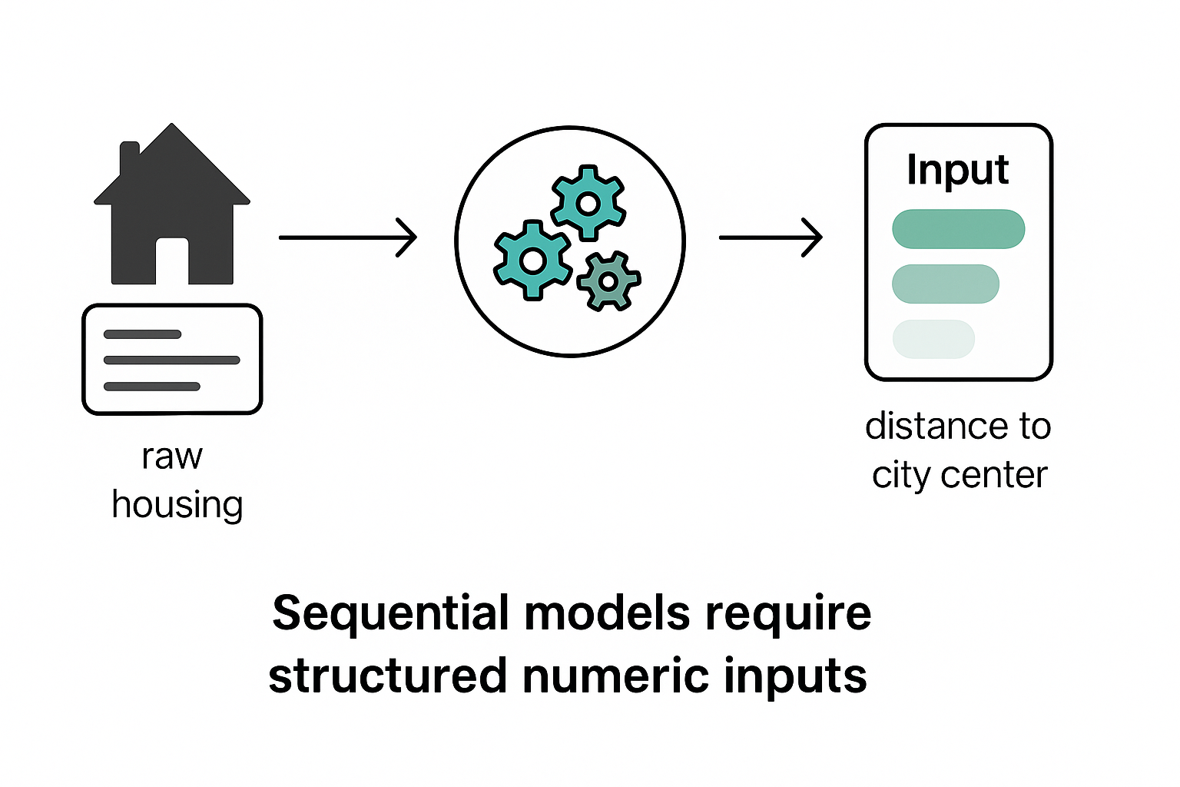
Why Feature Engineering Matters
Sequential models require structured numeric inputs
Quality of features > complexity of models
Encodes domain knowledge into data
Reduces noise, redundancy, improves interpretability
Example: Housing price → raw address vs distance to city center

Slide 3
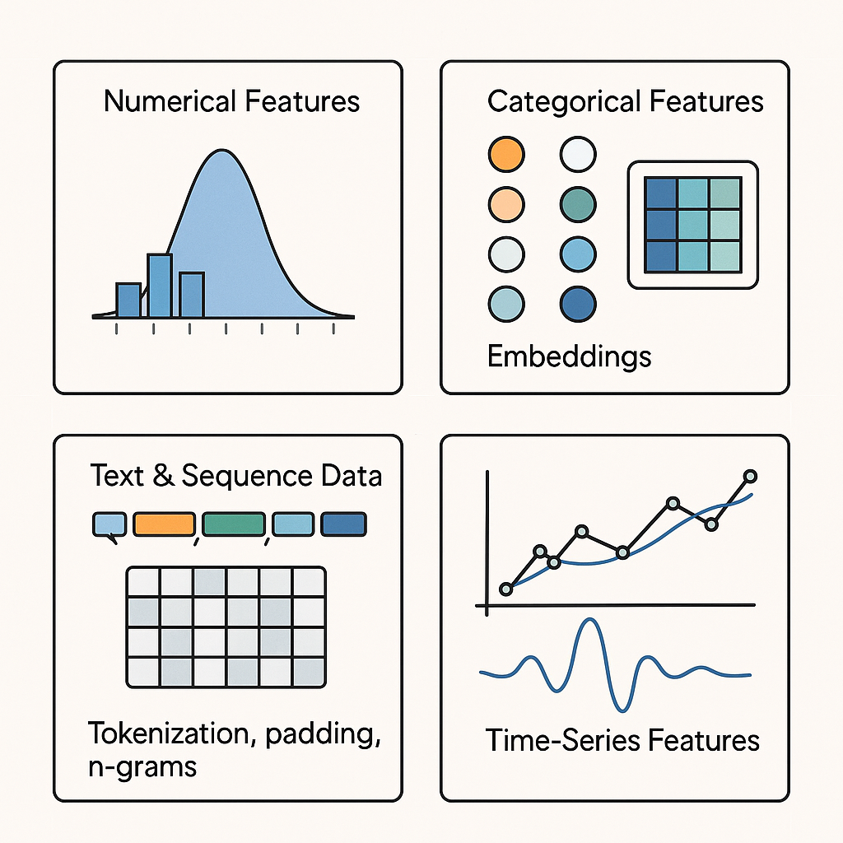
Core Techniques for Feature Engineering
Numerical Features:
• Normalization / Standardization
• Binning, polynomial expansion
Categorical Features:
• One-hot encoding
• Embeddings for Sequential models
Text & Sequence Data:
• Tokenization, padding, n-grams
• Pretrained embeddings
Time-Series Features:
• Lag features, moving averages
• Fourier transforms

Slide 4
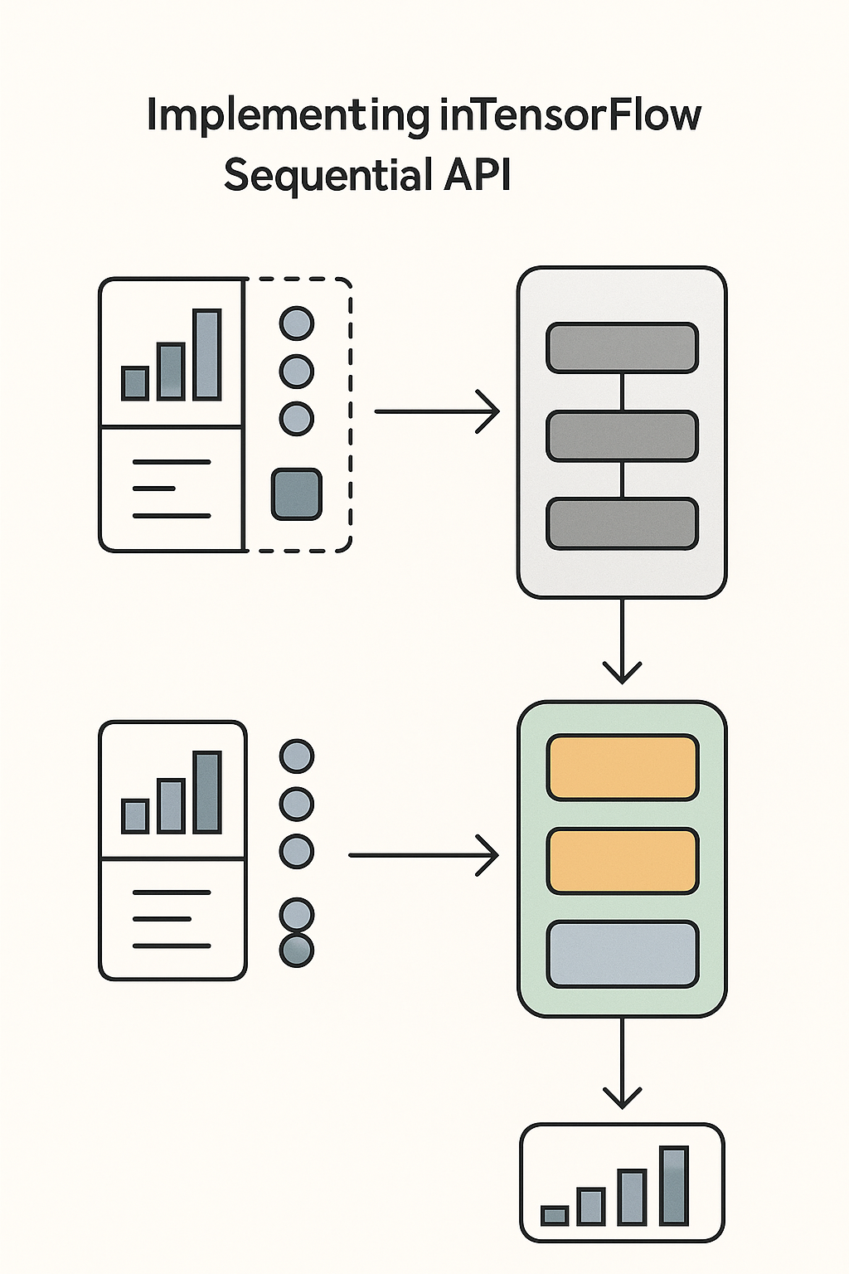
Implementing in TensorFlow Sequential API
Preprocessing Layers:
Normalization(), CategoryEncoding(), TextVectorization()
Feature pipelines with tf.data
Combine raw + engineered features
Example:
model = tf.keras.Sequential([
tf.keras.layers.Normalization(),
tf.keras.layers.Dense(64, activation='relu'),
tf.keras.layers.Dense(1)])

Slide 5

Best Practices & Takeaways
Start simple with baseline features
• Leverage domain knowledge
• Avoid data leakage
• Automate preprocessing (tf.data, Keras layers)
• Iterate: test, evaluate, refine
Key idea: Better features often beat bigger models

Slide 6
THANK YOU
Patrick Hill
phill86037@uat.edu
August 16, 2025
Note: Illustrations created by ChatGPT 5

